Slide 1
Lab Notebook
METC-143
Kevin Keating
08/01/2013

Slide 2
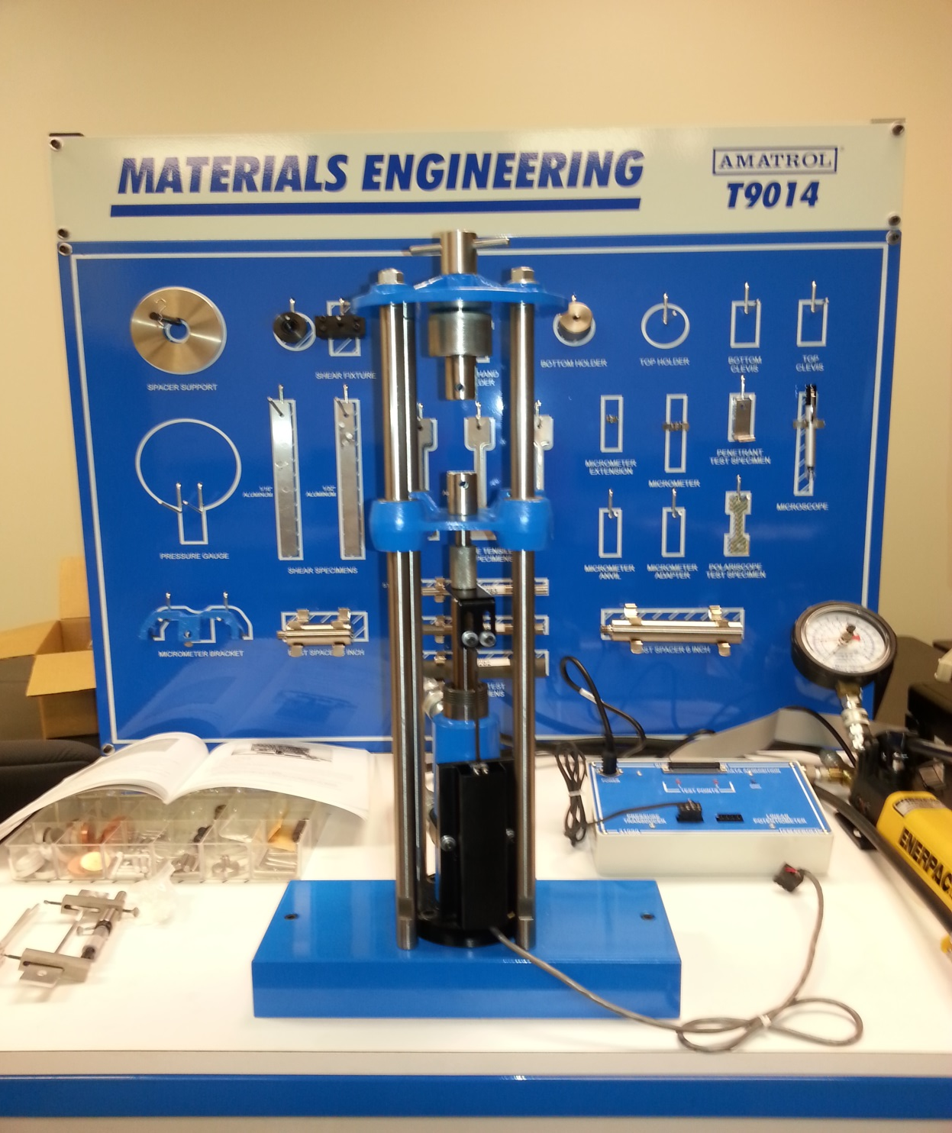
Lab #1
Verifying the Parts and Specimens for the Amatrol T9014
06/13/2013

Slide 3
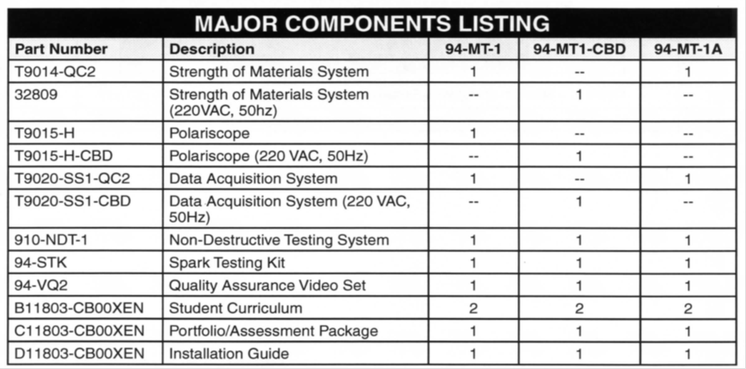
Lab #1 Continued

Slide 4
Lab #1 continued

Slide 5
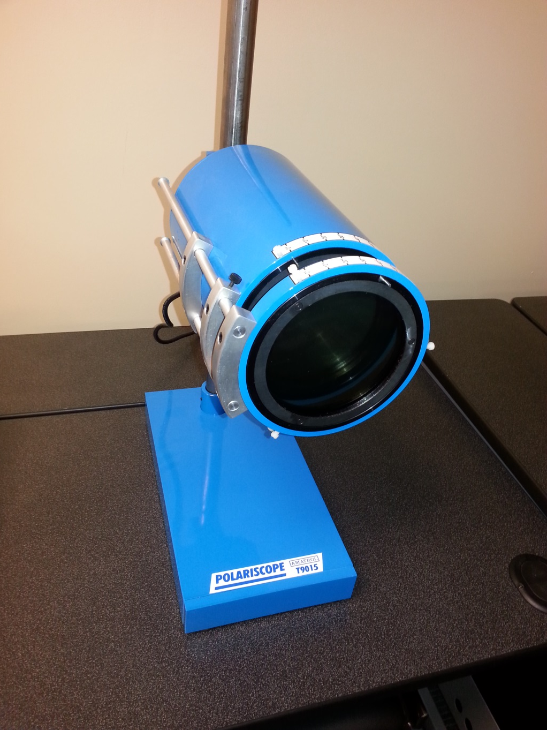
Lab #2
Checking the Operation/ Testing the Amatrol T9015 Polariscope
6/20/13

Slide 6
Lab #2 continued

Slide 7
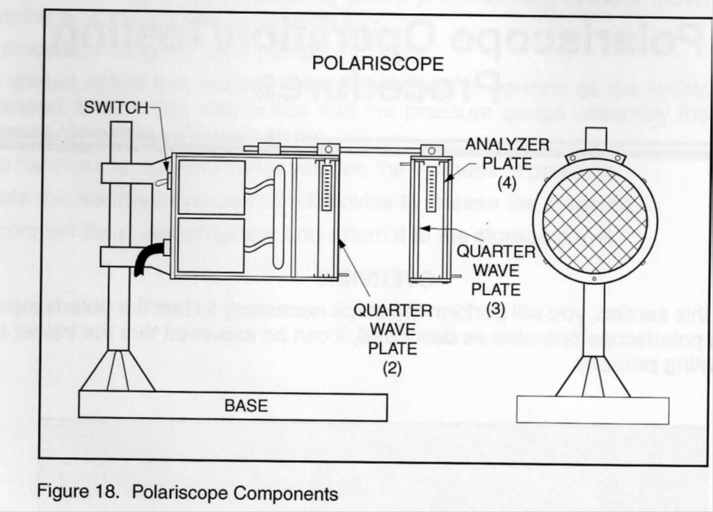
Lab #2 continued

Slide 8
Lab #2 continued

Slide 9
Lab #3
Shear Testing and Analysis
06/20/13

Slide 10
Lab #3 continued

Slide 11
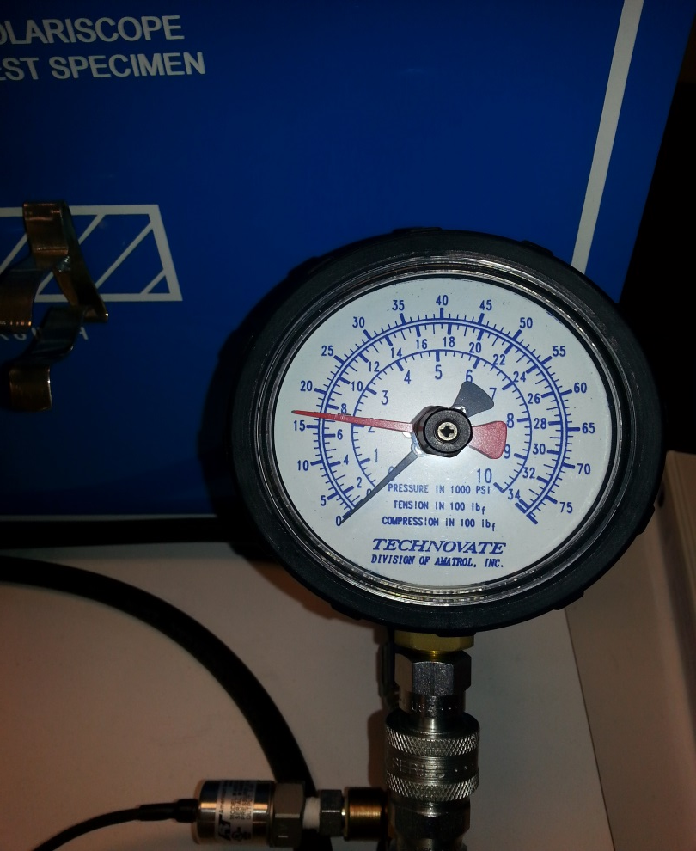
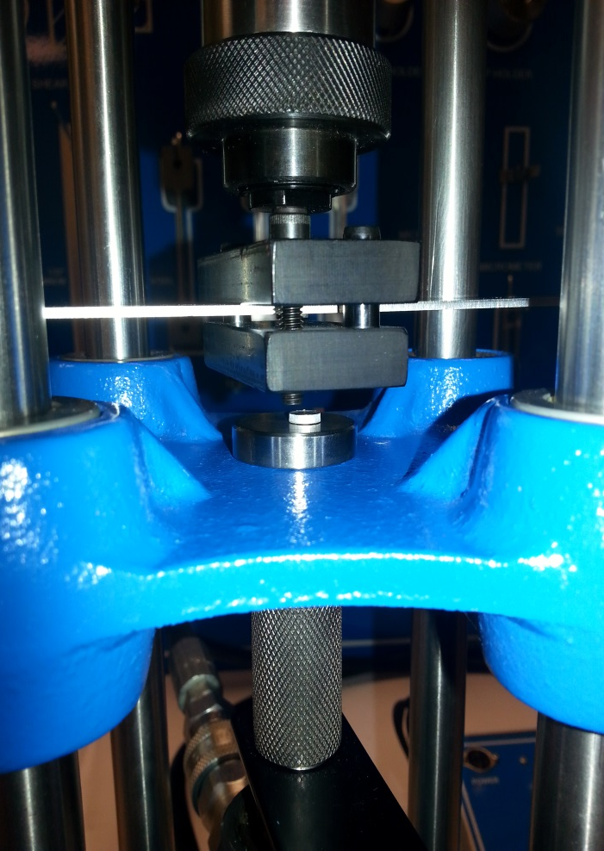
Lab #3 continued
Pressure gauge red arrows shows break psi
Shear Test Setup
Test specimen after testing

Slide 12
Lab #3 continued
Pressure | Shear Force | Shear Sress
1700 | 176556.407 | 17324.719 | 1/16in Aluminum Specimen |  |  | TEST # 1
450 | 46735.52 | 4585.955 | 1/32in Aluminum Specimen
Surface Area = | 89/907
Pressure | Shear Force | Shear Sress
1700 | 176556.407 | 17324.719 | 1/16in Aluminum Specimen |  |  | TEST # 2
450 | 46735.52 | 4585.955 | 1/32in Aluminum Specimen
Surface Area = | 89/907
Pressure | Shear Force | Shear Sress
1700 | 176556.407 | 17324.719 | 1/16in Aluminum Specimen |  |  | TEST # 3
450 | 46735.52 | 4585.955 | 1/32in Aluminum Specimen
Surface Area = | 89/907

Slide 13
Lab #3 continued

Slide 14
Lab #4
Brinell Hardness Test
06/25/13

Slide 15
Lab #4 continued

Slide 16
Lab #4 continued
Copper Specimen
after testing
Aluminum Specimen
After testing
Pressure Gauge showing 500 psi as per specifications

Slide 17
Lab #4 continued
Brinell Hardness Test with Aluminum specimen
setup

Slide 18
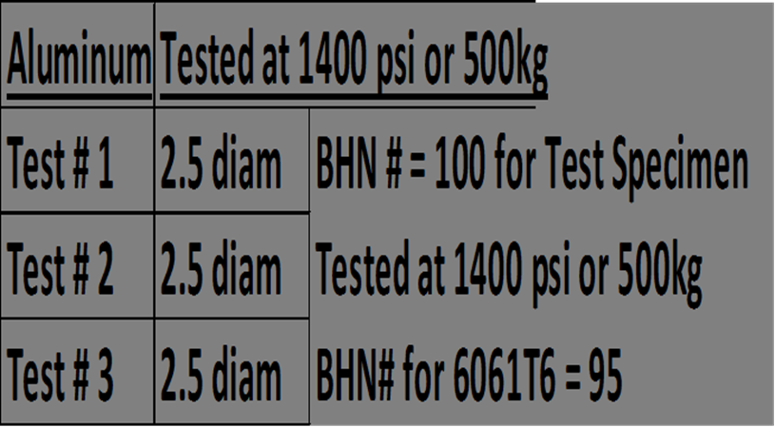
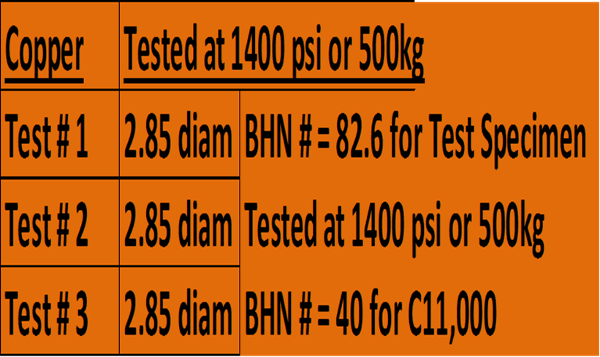
Lab #4 continued
Brinell Hardness Test Results

Slide 19
Lab #4 continued

Slide 20
Lab #5
Tensile Stress Test
7/2/13

Slide 21
Lab #5 continued

Slide 22
Lab #5 continued
6
A
ttach
the anvil to the bottom of the steel specimen just below
the bottom of the cutout.
7.
Slide the specimen into the top clevis and
attach by inserting a
dowel pin through the clevis and specimen
8.
Release the pressure from the hydrauli
c pump by turning the
pressure relief valve counter clockwise.
9.
Adjust the bottom spider
assembly and insert the bottom part of
the specimen into the bottom clevis.
10.
The pressure hoses going from the pump to the jack should be
checked so the cylinder is pulling and not pushing.
Switch hoses if
necessary.
11.
Set the red indicator arrow to zero.
12.
Close the pressure relief valve by turning clockwise.
13.
Using the hand pump increase the pressure by 200 psi increments
and record the length of the specimen
at each increment using
the mi
crometer.

Slide 23
Lab #5 continued
Stress Strain Data Sheet
Test Specimen
Type: Steel
Dimensions: |  | Gage Length= | 3 | inches
Cross-Sectional Area: |  | in²
Increment | Pump Pressure (ps) | Cylinder Force (lbs) | Micrometer Reading (inches) | Gage Length (inches) | Stress (psi)
1 | 0 | 0 | 0 | 3 | 1
2 | 200 |  | 0.005 | 3.005 | 1.001667
3 | 400 |  | 0.007 | 3.007 | 1.002333
4 | 600 |  | 0.009 | 3.009 | 1.003
5 | 800 |  | 0.01 | 3.01 | 1.003333
6 | 1200 |  | 0.013 | 3.013 | 1.004333
7 | 1600 |  | 0.016 | 3.016 | 1.005333
8 | 2000 |  | 0.023 | 3.023 | 1.007667
9 | 2200 |  | 0.102 | 3.102 | 1.034
10 | 2300 |  | 0.206 | 3.206 | 1.068667
11 | 2400 |  | Broke | 0 | 0

Slide 24
Lab #5 continued
Stress Strain Data Sheet
Test Specimen
Type: | Aluminum
Dimensions: |  | Gage Length= | 3 | inches
Cross-Sectional Area: |  | in²
Increment | Pump Pressure (ps) | Cylinder Force (lbs) | Micrometer Reading (inches) | Gage Length (inches) | Stress (psi)
1 | 0 | 0 | 0 | 3 | 1
2 | 200 |  | 0.001 | 3.001 | 1.000333333
3 | 400 |  | 0.01 | 3.01 | 1.003333333
4 | 600 |  | 0.012 | 3.012 | 1.004
5 | 800 |  | 0.021 | 3.021 | 1.007
6 | 1000 |  | 0.1 | 3.1 | 1.033333333
7 | 1100 |  | 0.103 | 3.103 | 1.034333333
8 | 1200 |  | 0.106 | 3.106 | 1.035333333
9 | 1300 |  | 0.109 | 3.109 | 1.036333333
10 | 1350 |  | 0.208 | 3.208 | 1.069333333
11 | 1400 |  | 0.218 | 3.218 | 1.072666667
12 | 1450 |  | 0.422 | 3.422 | 1.140666667
13 | 1500 |  | 0.503 | 3.503 | 1.167666667
14 | 1550 |  | 0.819 | 3.819 | 1.273
15 | 1600 |  | Broke | 0 | 0

Slide 25
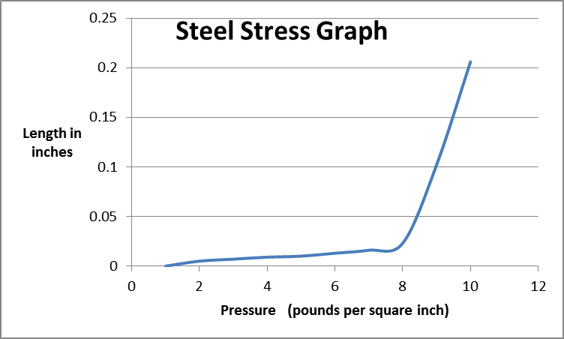
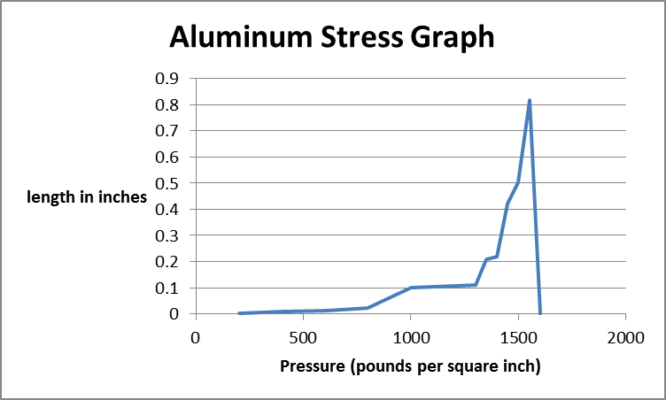
Lab #5 continued

Slide 26
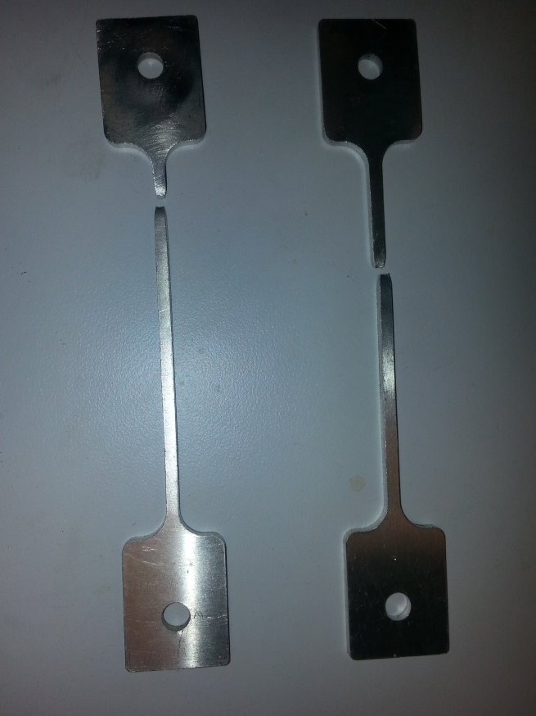
Lab #5 continued
Specimens after test;
Aluminum (left Steel (right)

Slide 27
Lab #6
Data Acquisition
7/9/13

Slide 28
Lab #6 continued

Slide 29
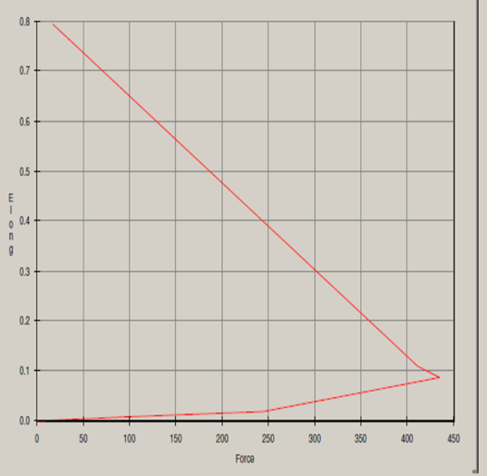
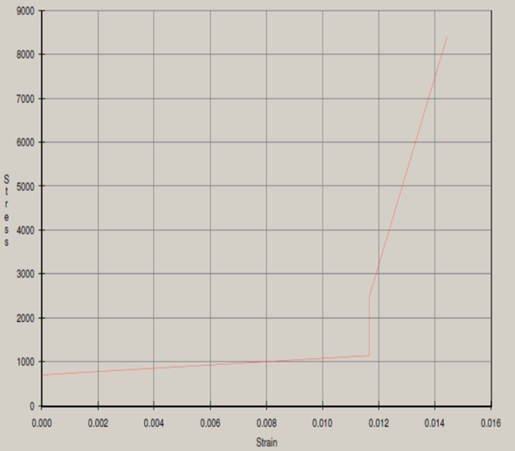
Lab #6 continued
Aluminum Tensile Test
Steel Tensile Test

Slide 30
Lab #7
Compression Test
7/16/13

Slide 31
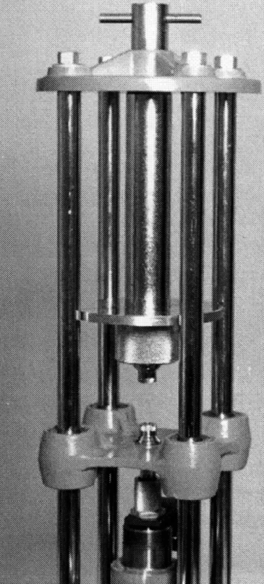
Lab #7 continued
4.
Slide the 6 inch
post
spacer
through the hole in the center of
the support spacer and attach the post to the top spider
as
sembly using the top hand screw
5.
Attach the bottom compression adapter to the lower spider
bracket using the threads in the cylinder.
6.
Release hydraulic pressure by turning the
Pressure relief valve on the
hydraulic pump counterclockwise.
7.
Place the aluminum compression specimen in the upper compression
adapter and bring the lower adapter fitting up to meet it.
8.
Make sure the red arrow on the pressure gauge is set to zero.

Slide 32
Lab #7 continued
9.
Close the pressure relief valve by turning it clockwise until tight.
10.
P
ump hydraulic hand pump until the specimen distorts
.
N
ote
: be sure
hydraulic hoses are set so that the hydraulic cylinder pushes and
doesn
’t pull. If the cylinder pulls then relieve the pressure in the
cylinder and reverse the hoses.
Observations:
The hoses started
leaking at 3500 psi.
Conclusion
:
The steel sample did not deform as much as the aluminum sample
did.

Slide 33
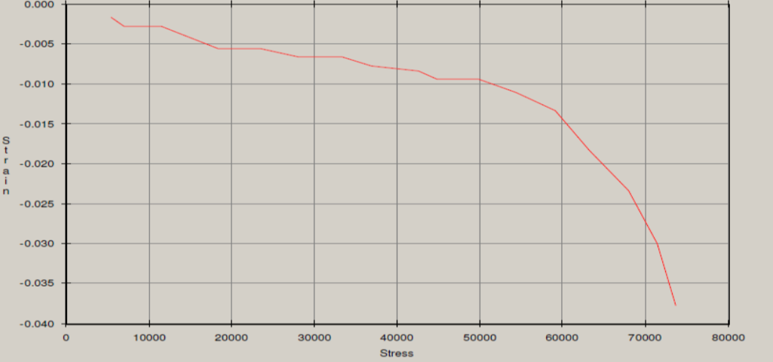
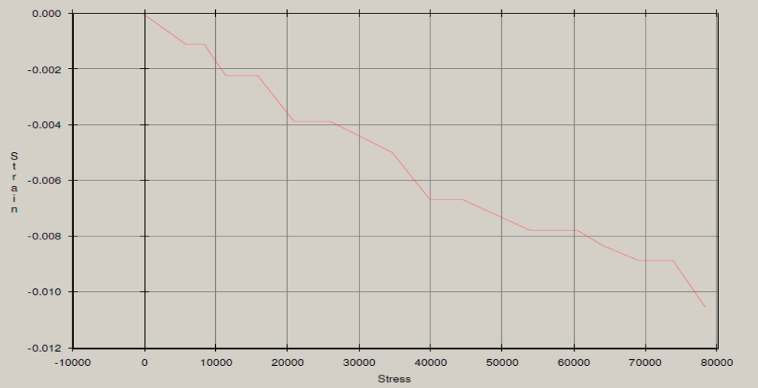
Lab #7 continued
Data Acquisition Sotware Graphs
Aluminum Compression Test
Steel Compresson Test

Slide 34
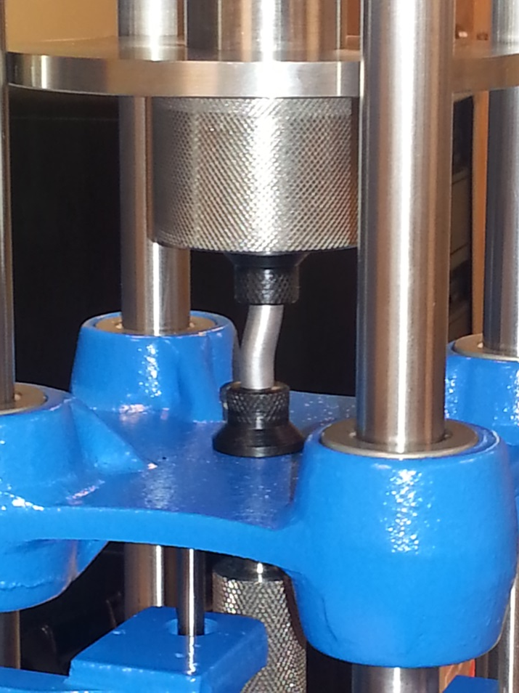
Lab #7 continued
Steel Samples:
Tested Sample is on left
Compression Test with aluminum at3500 psi
Aluminum Samples: Tested sample is on left

Slide 35
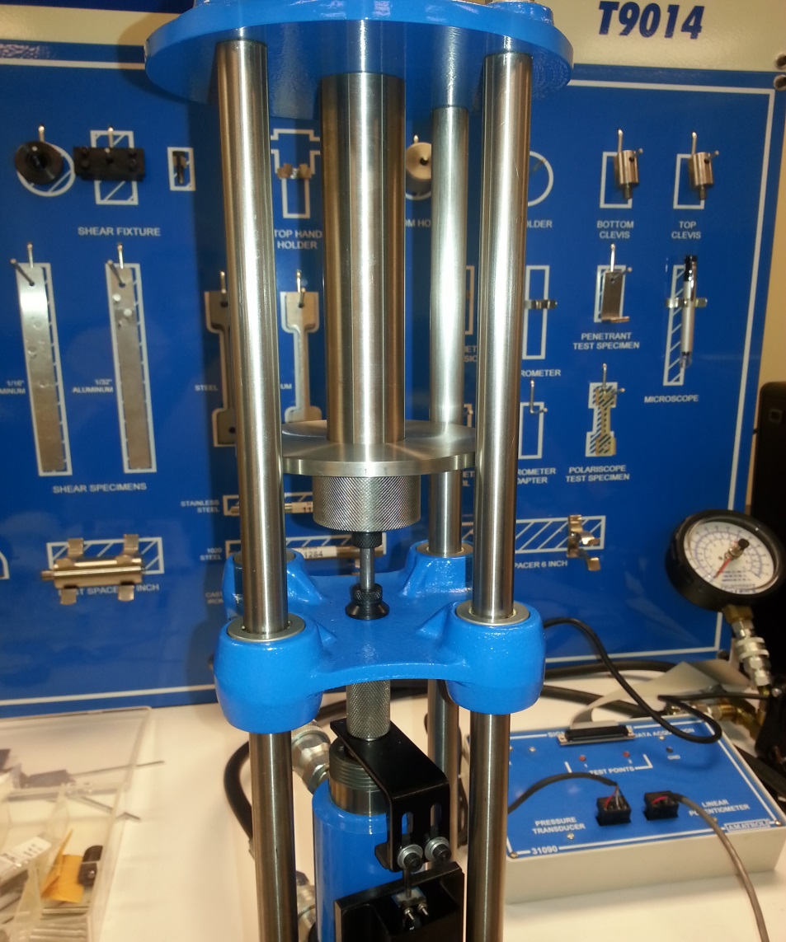
Lab #7 continued
Compression Test Setup

Slide 36
Lab #8
Cantilever Frequency
7/30/13

Slide 37
Lab #8 continued
Formula: f=((#oscilations)*(frames/second))/(#frames)

Slide 38
Lab #8 continued

Slide 39
Lab #8 continued
Video of Test of Thinner Material without any units added

